Slide 1



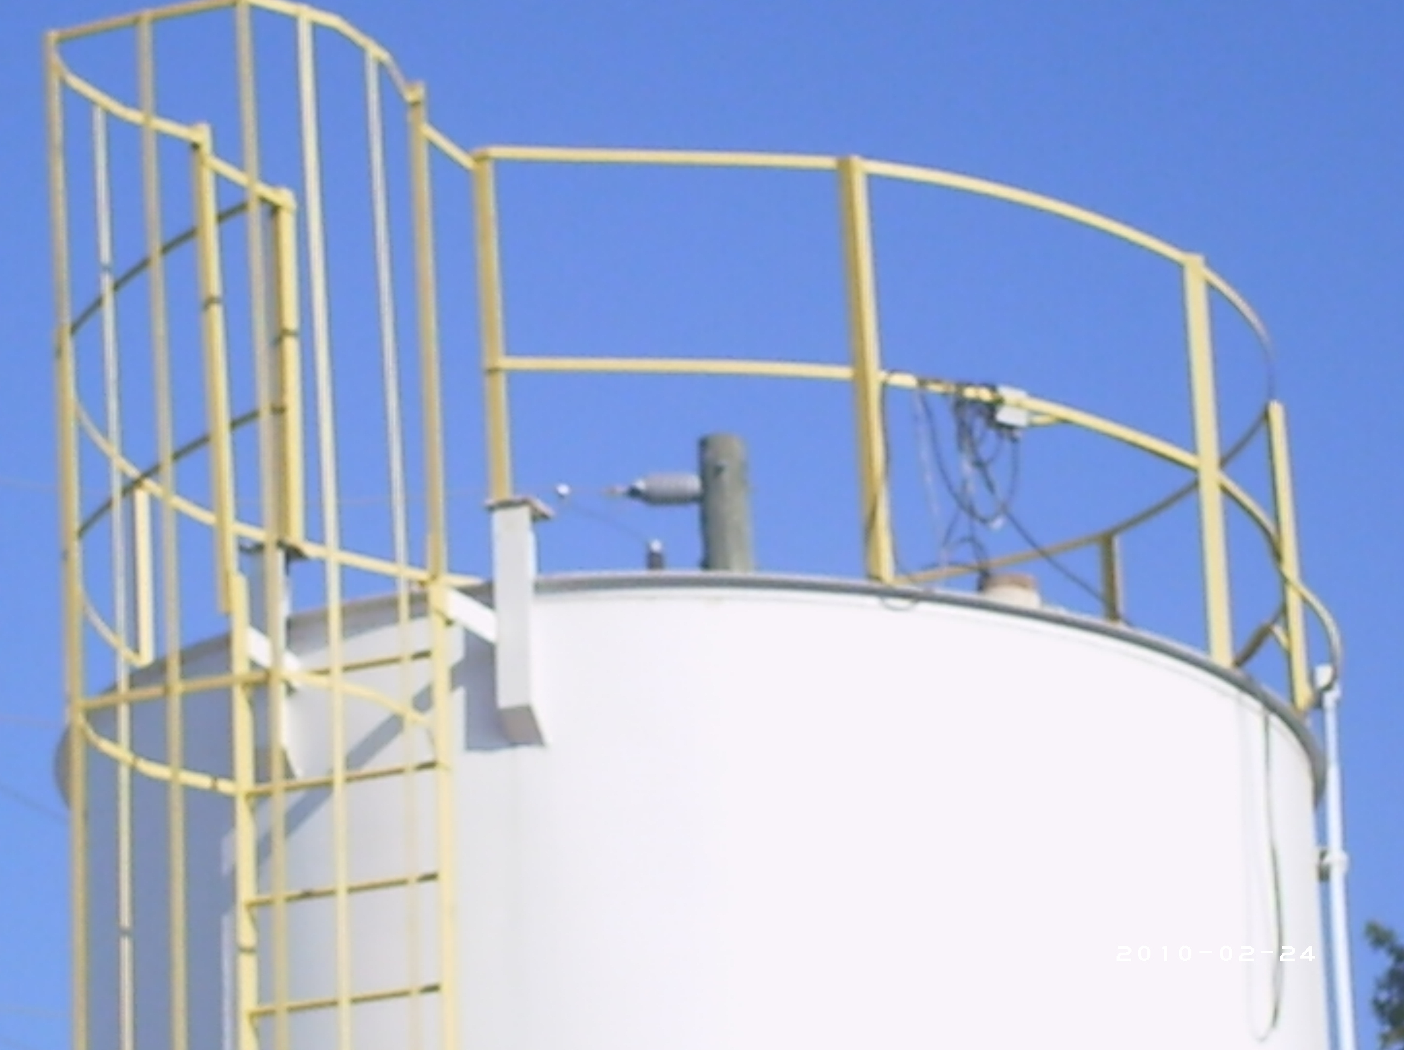
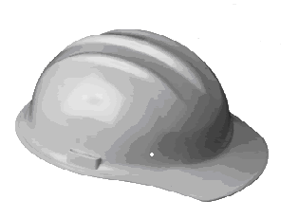

Gulf Atlantic Now Offers a Full Range of
Safety Services
Provided by a Certified Safety Professional (CSP)*
Services Offered Include:
  OSHA 10 hour On-Site training: construction/general industry
  OSHA 30 hour On-Site training: construction/general industry
  On-Site OSHA/Safety Training
  On-Site Safety Audits
  Accident Investigation
  Safety Culture Development
  Human Performance Evaluations
  Safety and Health Program Development
  OSHA Investigation Assistance
  Expert Witness Testimony
  Site Specific Safety Training for the
  Concrete Industry & More
How can we help? Contact Us Today!
352-628-6674 - Main Office
352-628-6774 - Fax
800-792-7427 - Toll Free
www.GulfAtlanticEquipment.com
info@GulfAtlanticEquipment.com
Let Us Help You Before OSHA Does!
*CSP, CUSA, OHST, and NRRPT Certified, Graduate New York University, Graduate Studies at University
Of South Florida, Graduate US Navy Nuclear Program, 20 Yrs. Experience in Safety Management,
Power Plant Operation, Radiation Protection Programs, and Water Chemistry Programs
Clients Include:
Progress Energy
Entergy
Tropicana
Nuclear Fuel Services
Dextra Environmental Group
Florida Power and Light
Central Florida Community College
Texaco
Conoco Philips
Shell
Babcock and Wilcox
Oklahoma Gas and Electric
A.D. Waller, Inc
Florida Rock Ind. / Vulcan Materials
Power Consulting Services
Monroe Regional Hospital
Standard Purification

